Slide 1
EE-449-07
Final Project Presentation
Harrison Power, Austin Ma, Christopher Barber

Slide 2
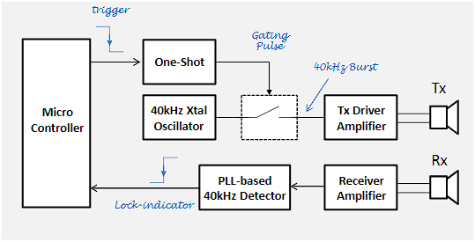
Overview

Slide 3
Overview
Notes:
Austin

Slide 4
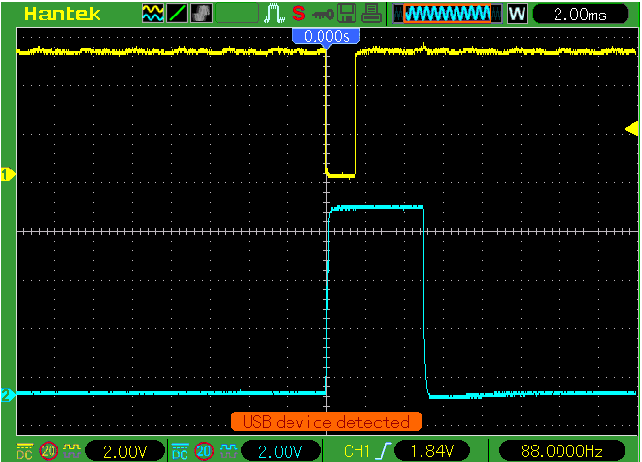
One-Shot
Arduino Input
One-Shot Output
Notes:
Austin

Slide 5
Overview
Notes:
Harrison

Slide 6
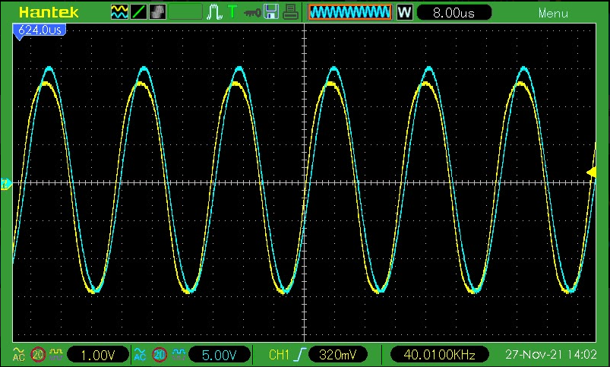
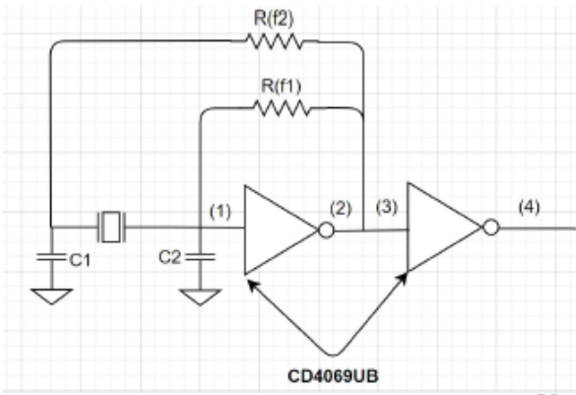
Oscillator attempt 1
R2=27kohm R1=10Mohm
C2=22pf C1=12pf
Barkhausen Criteria
Oscillator Circuit
Did not work despite near perfect Barkhausen. Reason unknown
Notes:
Harrison

Slide 7
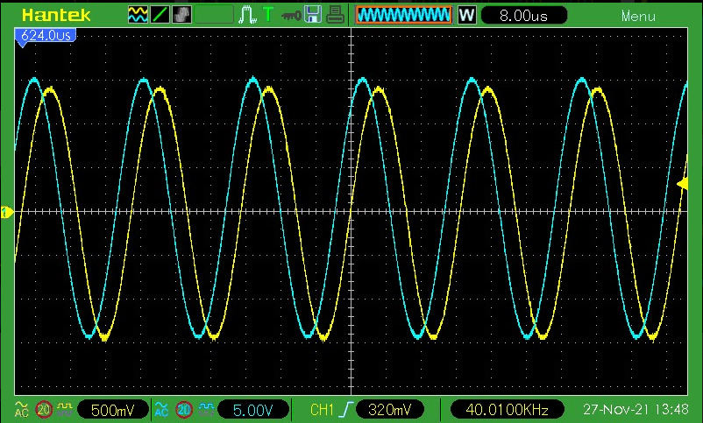
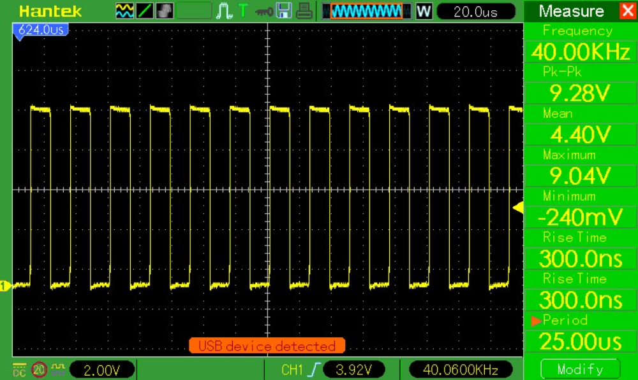
Oscillator attempt 2
R2=27kohm R1=10Mohm
C2=22pf C1=312pf
Oscillator Circuit
Barkhausen Criteria
Output Frequency
Notes:
Harrison

Slide 8
Overview
Notes:
Austin

Slide 9
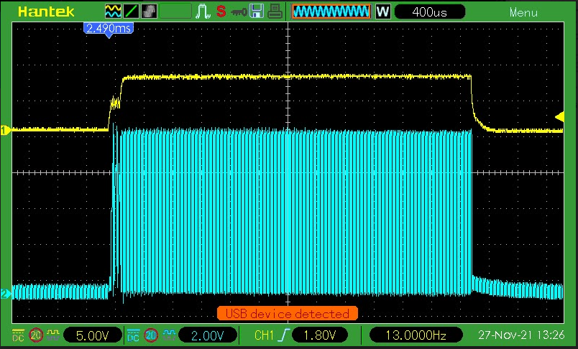
Gating Circuit
Notes:
Austin

Slide 10
Overview
Notes:
Christopher

Slide 11
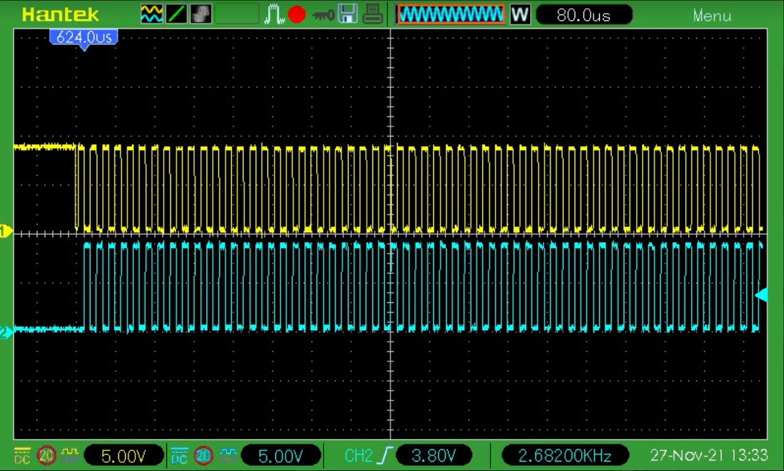
Tx Driver Circuit
Notes:
Christopher

Slide 12
Overview
Notes:
Christopher

Slide 13
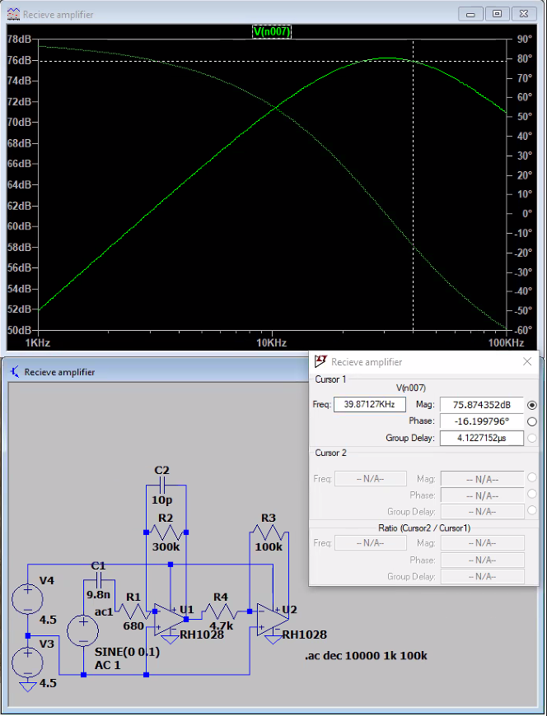
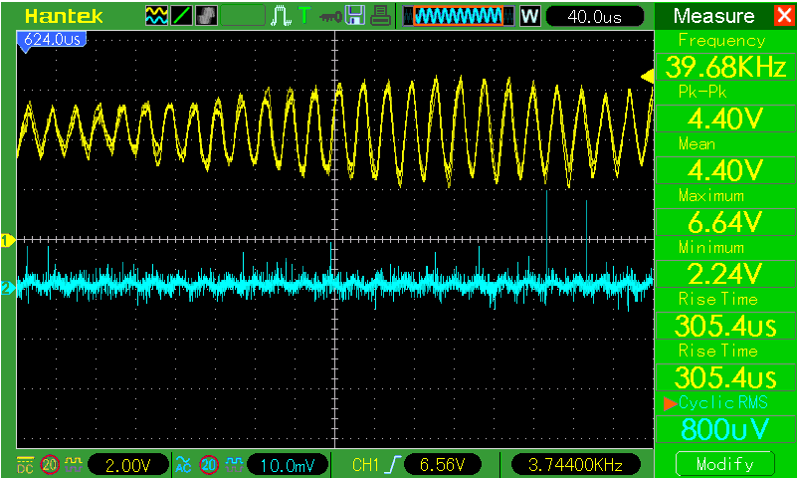
Receiver
This is a gain of 75.5dB.
Notes:
Christopher

Slide 14
Overview
Notes:
Harrison

Slide 15
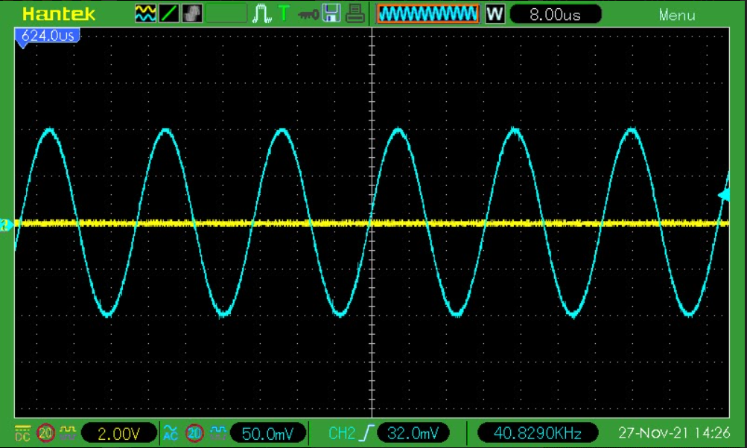
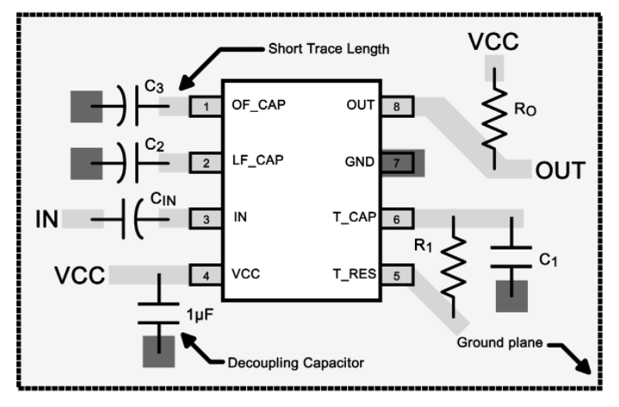
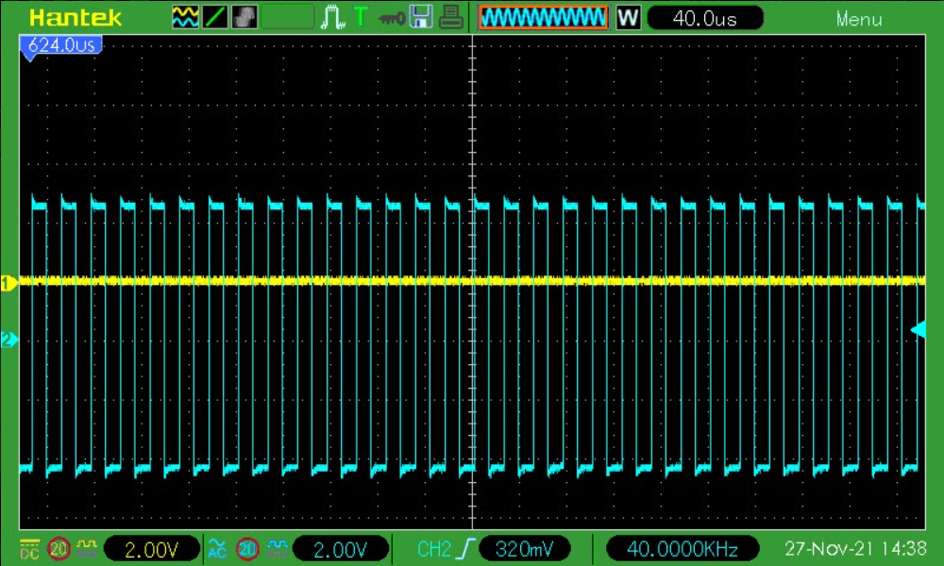
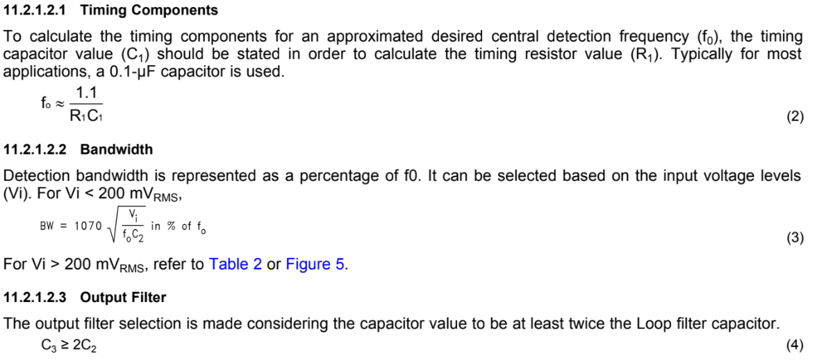
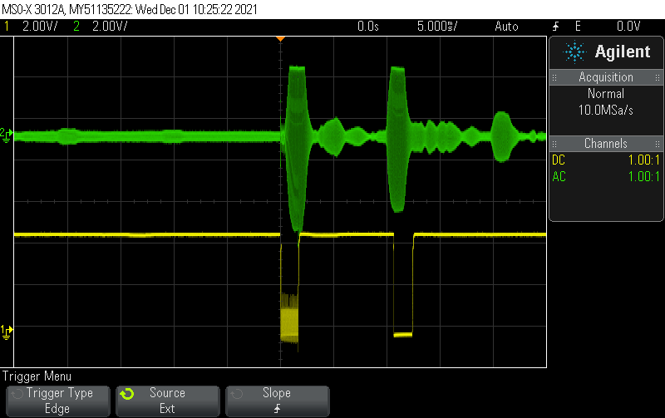
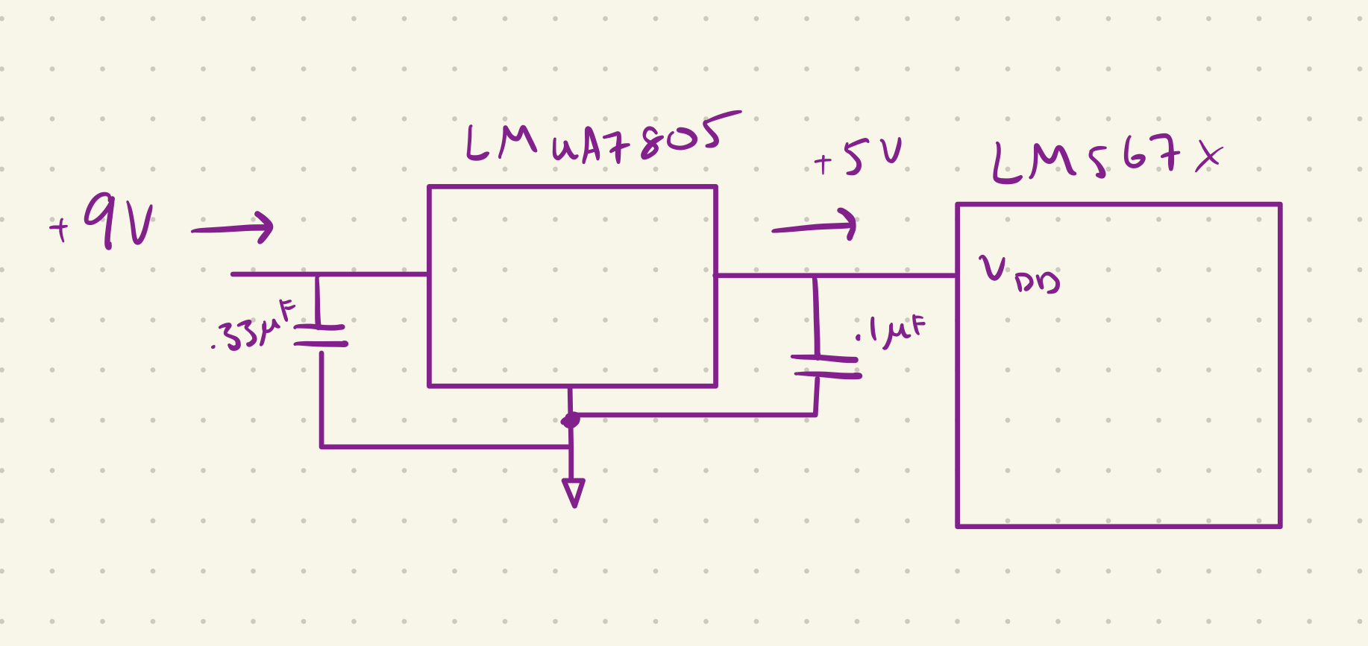
Phase Lock Loop
Using R1 of 2.7Kohm and C1 of 10nF gave a fo of 40.7KHz
To set the bandwidth we used a 47nF which gave us a bandwidth of approximately 12% of fo
C3 was set to 150nF in order to be larger than 2*C2
Note* Had to change PLL to 0-4.5V rails or it wouldn't work.
Center Frequency
Output
Filter
Bandwidth Calculation
Notes:
Harrison

Slide 16
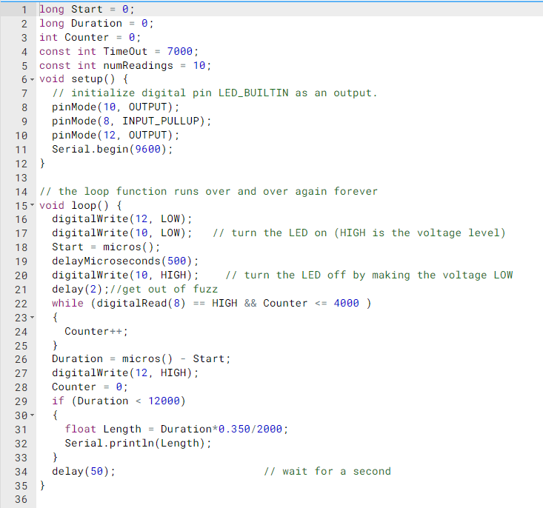
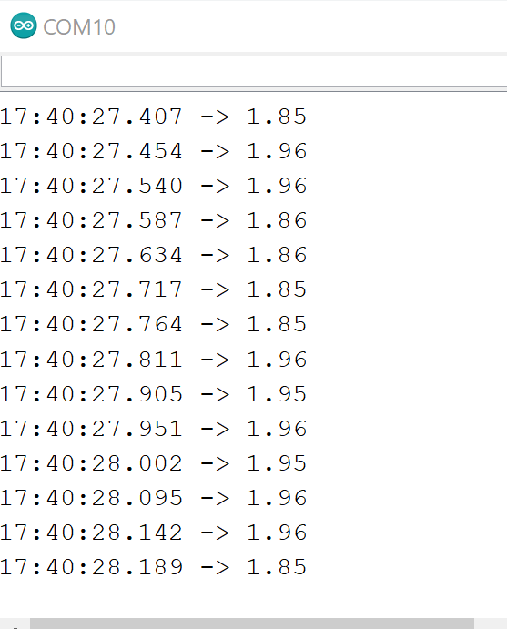
Code
Notes:
Christopher

Slide 17
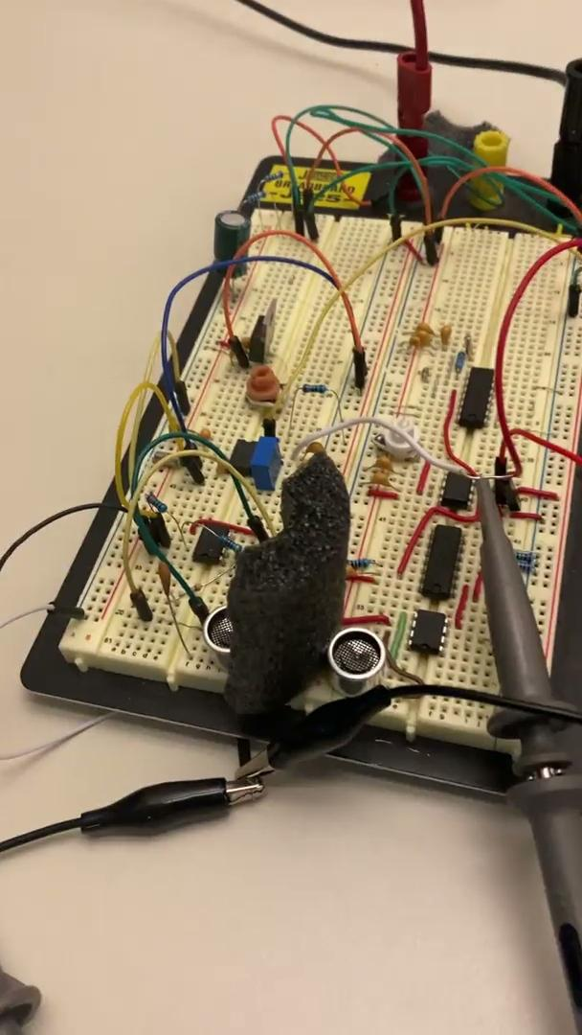
Video

Slide 18
Lessons Learned
Sometimes, future proofing can be a horrible idea
Defining clear and concise test cases can help debugging
If something doesn’t work, test every possible factor that was assumed to be correct
Creating organized circuits and prototyping with clean wires, and well placed components significantly helps construction
Rebuilding a circuit can often fix many issues and mistakes that aren't realized.
Humans have an ~300pF capacitance to a far away ground
PLL chip doesn’t work well at 8.5V, much better at 5V (operating close to limits bad :( )
Noise on power rails can cause issues for the PLL

Slide 19
Questions?

